Slide 1
Ethical Use of Autonomous vehicles in Healthcare AI

Slide 2
Agenda
Goals
Acknowledgment of ongoing technological advancements
Significant Impacts
Challenges
Ethical Considerations
Evolution & Significance of autonomous vehicles
Healthcare?
Impact

Slide 3
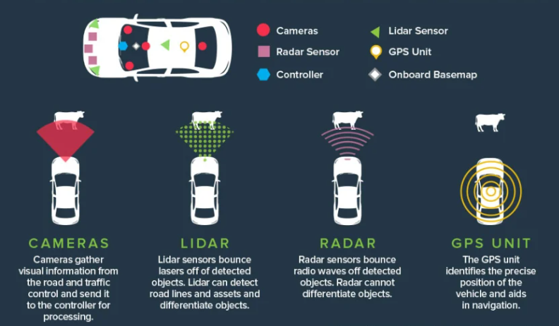
Autonomous vehicles - Glimpse
Combination of advanced sensors and Machine learning algorithms.

Slide 4
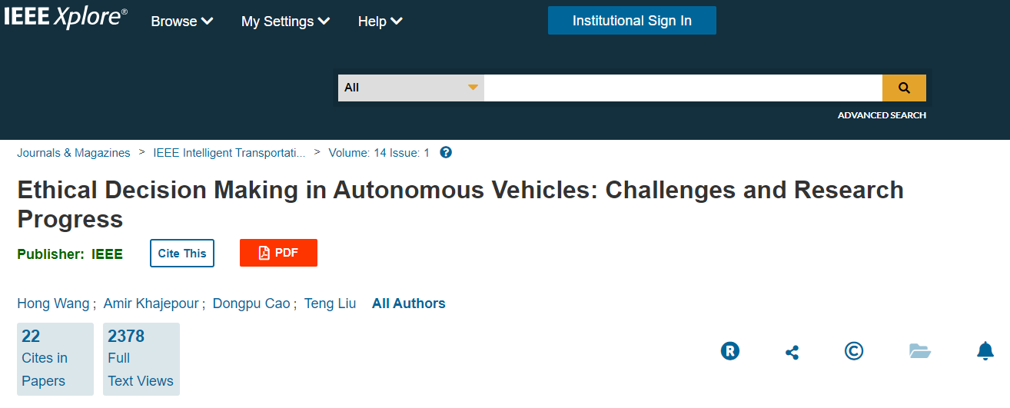
Ethical Considerations in Autonomous Vehicles
Decision-Making in Emergency Situations
Liability and Responsibility
Data Privacy and Security
Societal Impact and Accessibility

Slide 5
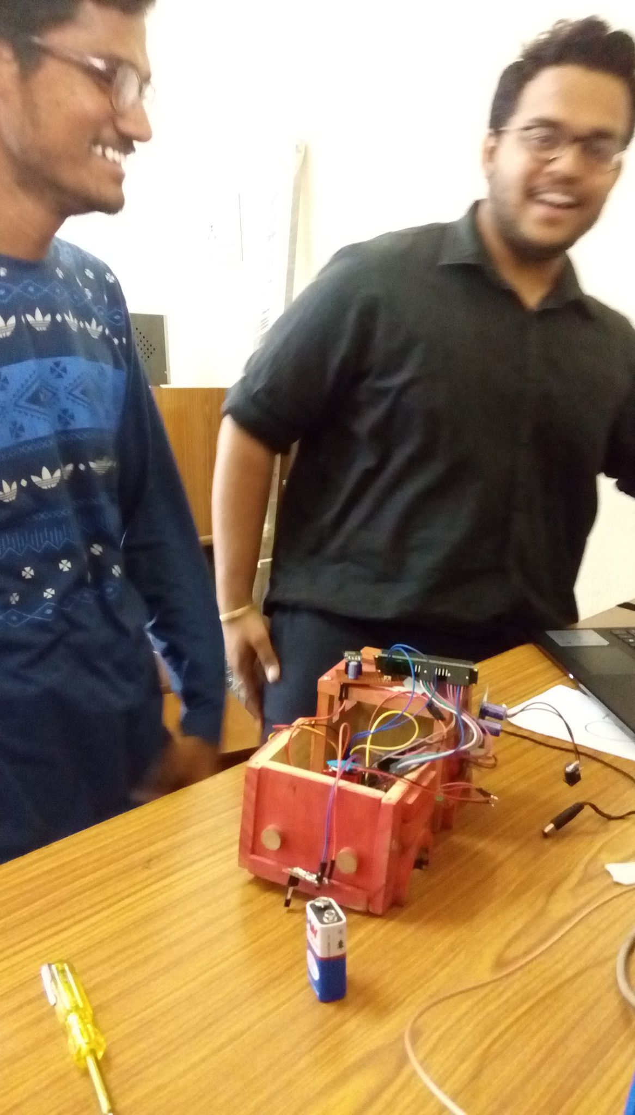
Autonomous vehicle prototype
Accident Detection and Vehicle condition monitoring - A project based on IOT.
Sensors like Arduino Uno, Accelerometer, Gyroscope, etc,.
Programming Language Embedded C and Python.
Cloud : Thingspeak

Slide 6
Autonomous Ambulance
Same prototype with additional features and sensors to make it automatic.
Needs vigorous testing of the source code to pass all possible test cases before finalizing.
Of course we do need a medical practitioner in the vehicle all the times except that its automatic.
Change the algorithm According to the sensors we do require.
Code base: https://github.com/arunmukkamla/Accident-Detection-and-Vehicle-Monitoring-IOT/blob/master/Main_code.ino

Slide 7

Code base explanation.
Its a portion of the code where it shows the sensors connected to the board. We can modify the code base here and make changes accordingly.
We can also monitor the Autonomous vehicles condition with the help of the cloud data which we’ll be sending to ThingSpeak.com

Slide 8
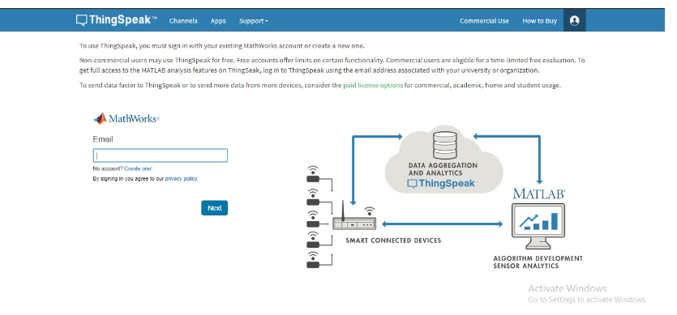
Vehicles Condition - Cloud Platform
ThingSpeak cloud
Notes:
ThingSpeak is an open-source software written in Ruby which allows users to communicate with internet enabled devices.^{[2]} It facilitates data access, retrieval and logging of data by providing an API to both the devices and social network websites.

Slide 9
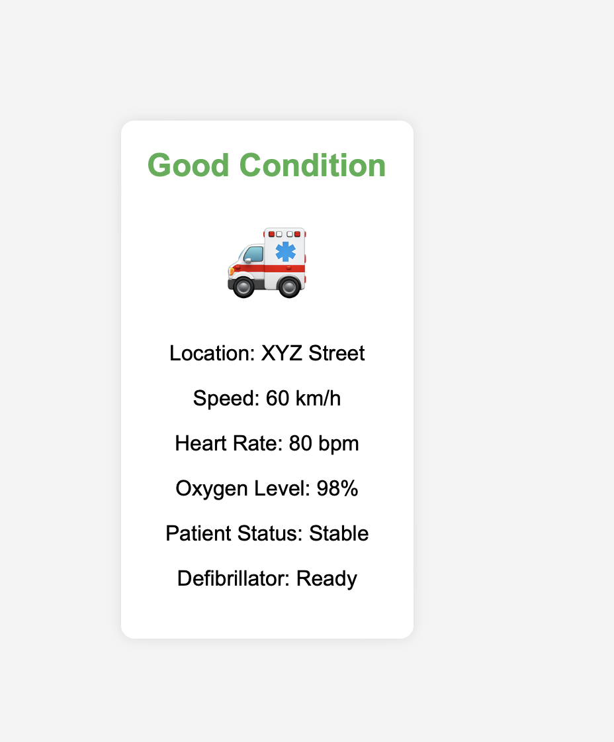
Vehicle Condition - Key Challenge
Bias Breakout: The criticality of issues, regardless of the geographic location or demographic information.
Clarity Crisis: Comprehensive but clear report highlighting critical issues.
Privacy Pursuit: Vehicle data is encrypted → limited to authenticated user.
Notes:
Our autonomous ambulances prioritize your safety with encrypted data, ensuring only trusted users access vital information. Our transparent reports spotlight critical issues, providing a clear picture of emergencies. No matter where you are, our algorithms are fair and unbiased, prioritizing urgency over demographics.

Slide 10
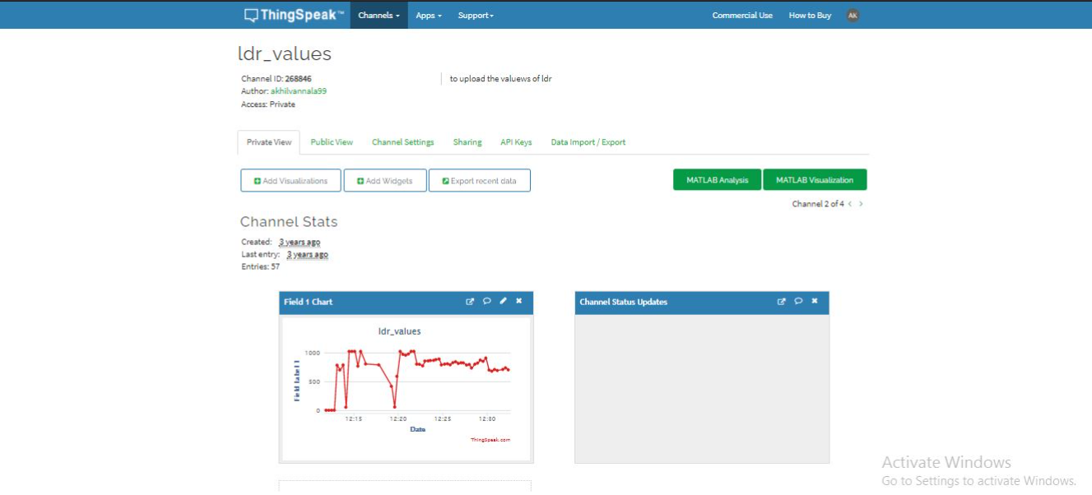
Graphs.
One sensor data: Here it is Temperature sensor data ( accelerometer, gyroscope etc,..)

Slide 11
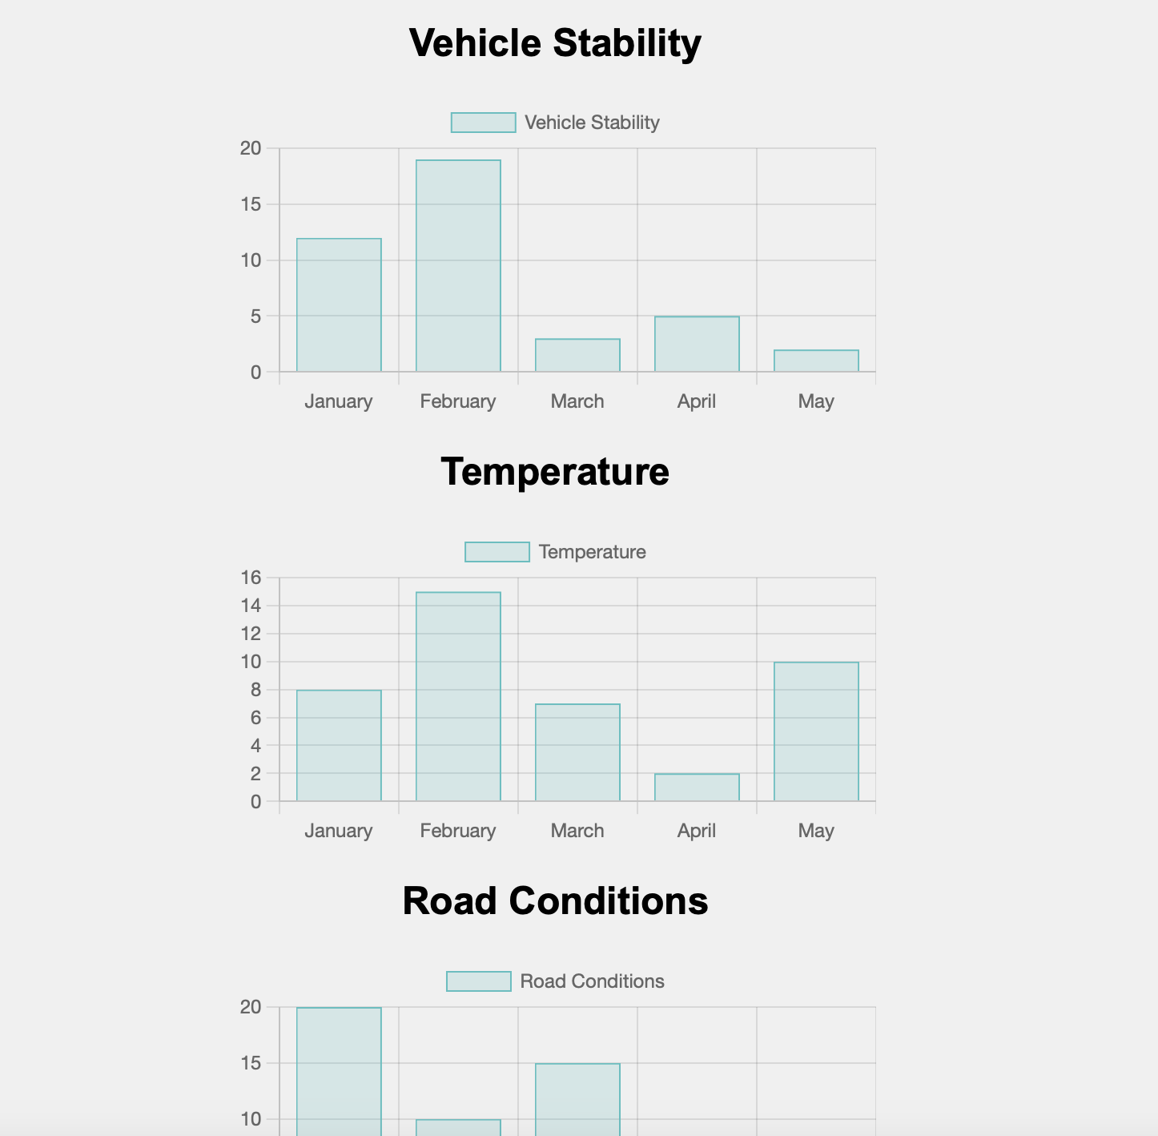
Graphs - Key Guiding Questions
Does it show a diverse range of scenarios ?: routine and challenging conditions
Does it cover all Categories?: weather, road complexity, and traffic density
Is it Transparent? : successful scenarios and instances requiring human intervention

Slide 12
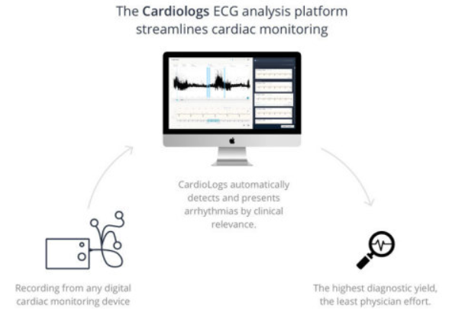
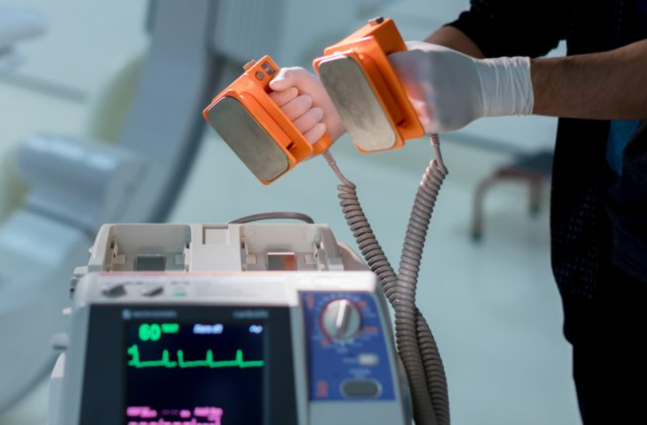
What IF - EMS Equipments are integrated AI??
Automated External Defibrillator -
Machine Learning models - identifies the heart rhythm
In future - possible to give the patient condition.
Cardiac Monitoring -
Detect early cardiac abnormalities
Oxford University - AI in Cardiology saves thousands of lives.
Large set to Dataset to be trained

Slide 13
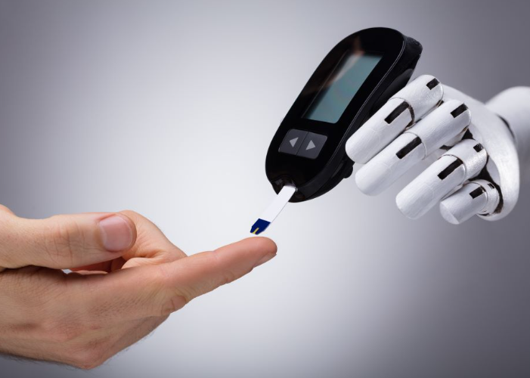
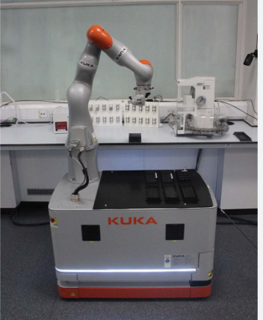
What IF - EMS Equipments are integrated AI? - Contd
Portable Lab Equipments -
Blood Tests lab and other Diagnostic Labs
Doctors can get reports of patient before reaching hospital.
Glucose Monitoring Equipment -
With AI - Better Blood Sugar Management.
Association of Diabetes care and education Specialists - no need to bother about what they are eating

Slide 14
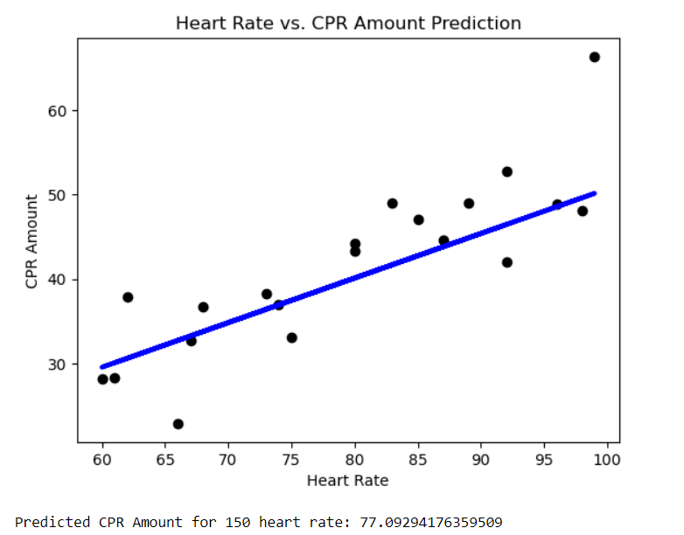
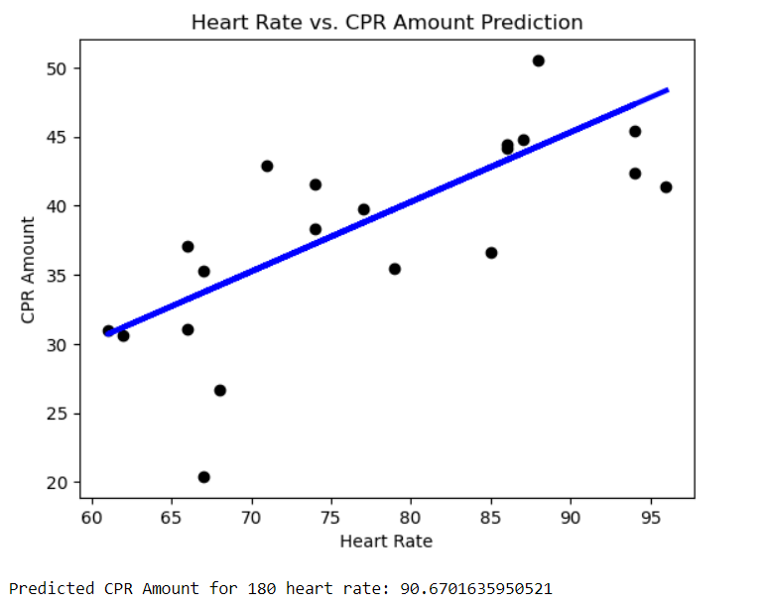
Health Care - POC
Python code - Model is simple linear regression to predict Cardiopulmonary Resuscitation (CPR) amounts based on heart rate data.

Slide 15
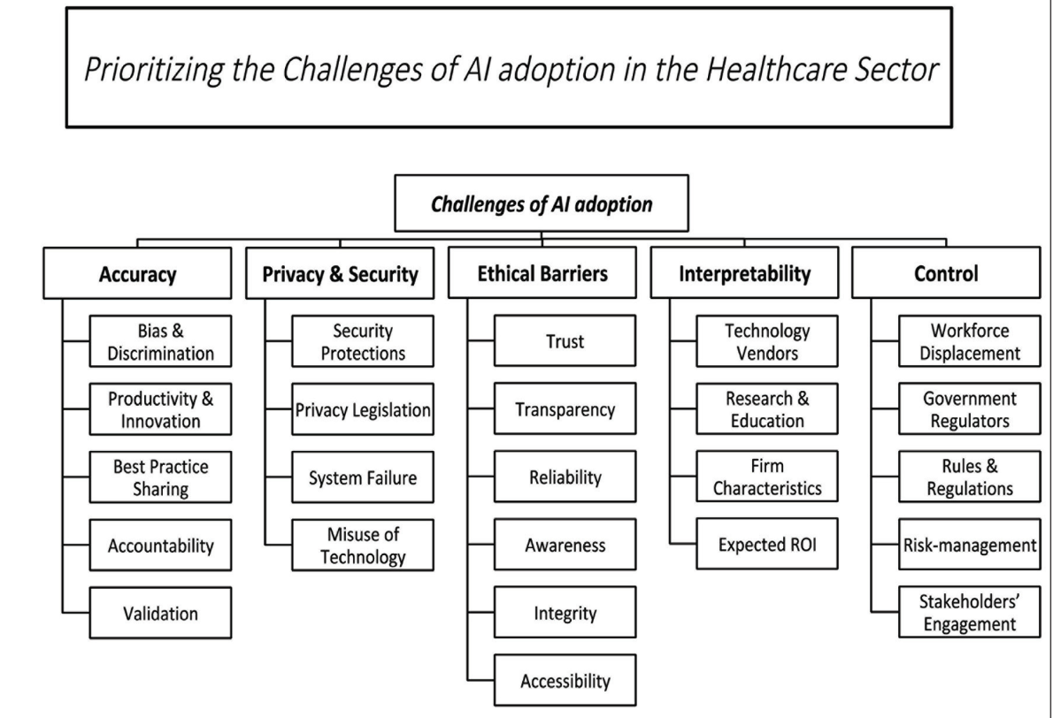
Challenges of AI adoption in Healthcare.

Slide 16
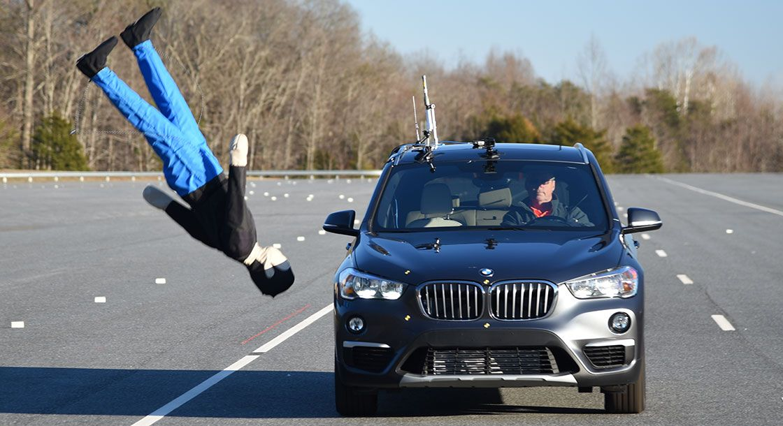
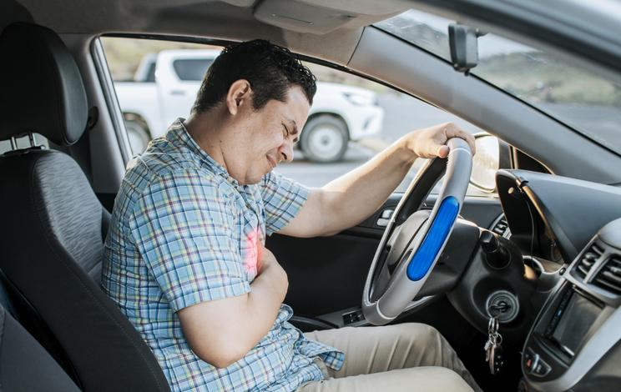

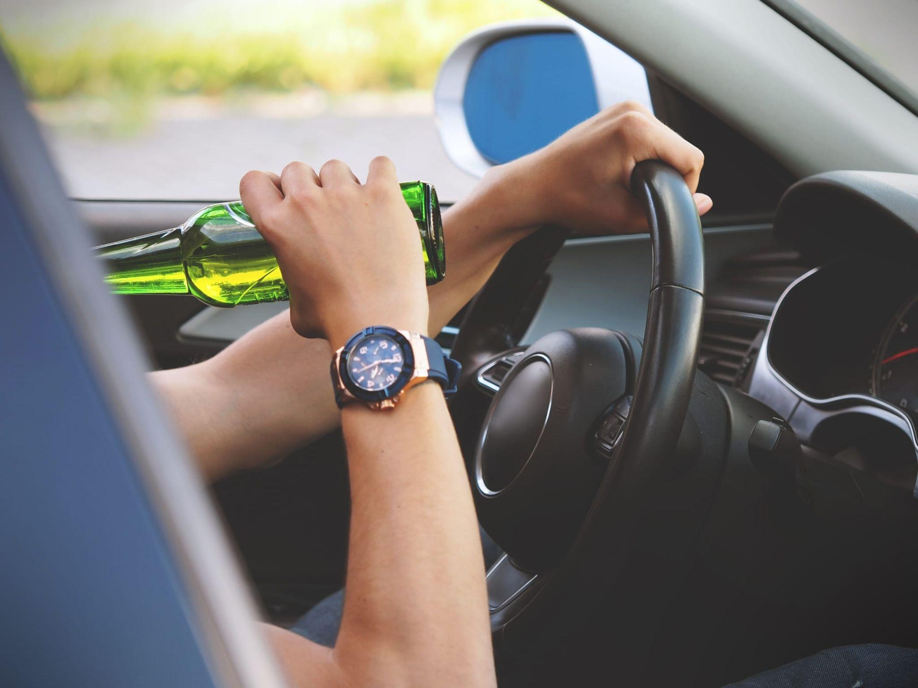
Crucial Advancements and Healthcare impacts of AV’s :
AV’s as - Ambulance ,Trucks , Ridesharing cars, mobility pods, Mobile medical vehicles and cargo vehicles .
Direct and Indirect Impacts - Traffic Safety - During attack of illness - Substance Abuse - Road Rage or hijacks control - Stress & more

Slide 17
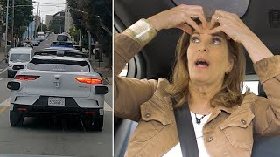
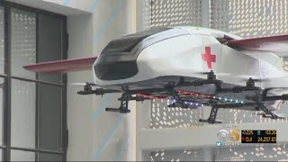
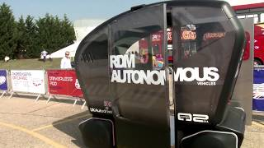
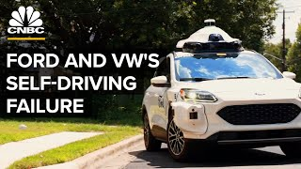
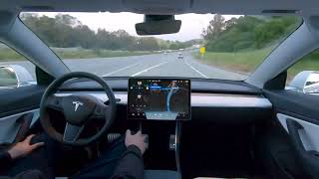
Waymo -Googles investment
SoCal Lab Autonomous Air Ambulance
Richmond Marketing and Design
Ford and VW’s investment in ArgoAI in 2017
Tesla self driving test

Slide 18
Thank you!
Any Questions ?

Slide 19
References
https://www.sunrise-vw.com/will-volkswagen-have-a-self-driving-ambulance-ready-by-2025/
https://www.behance.net/gallery/98221749/Median-AMB-Expressway-Ambulance-System

Slide 20
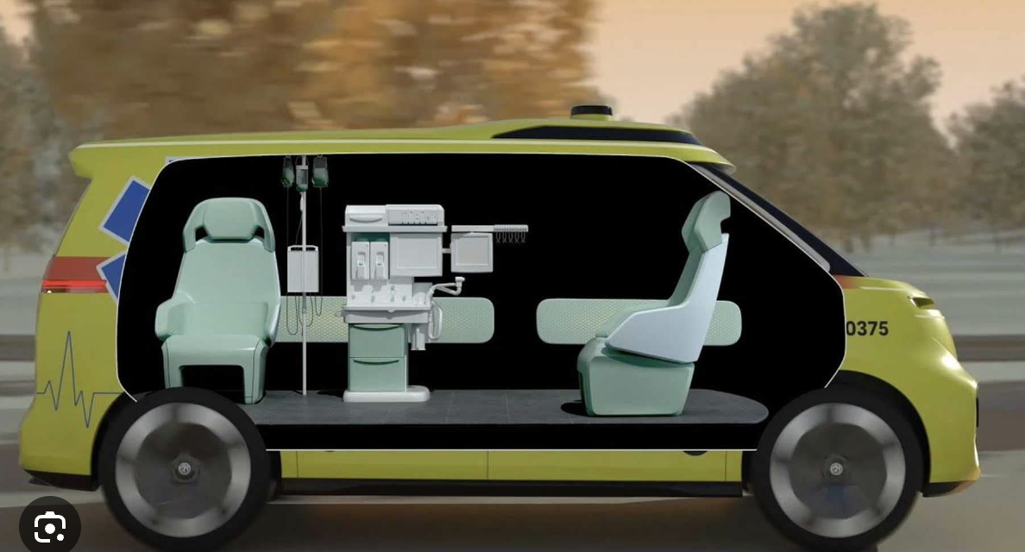
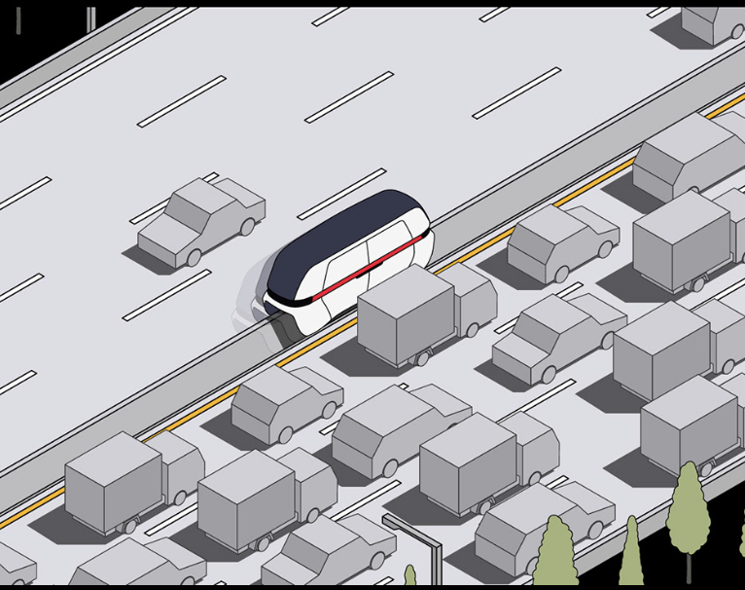
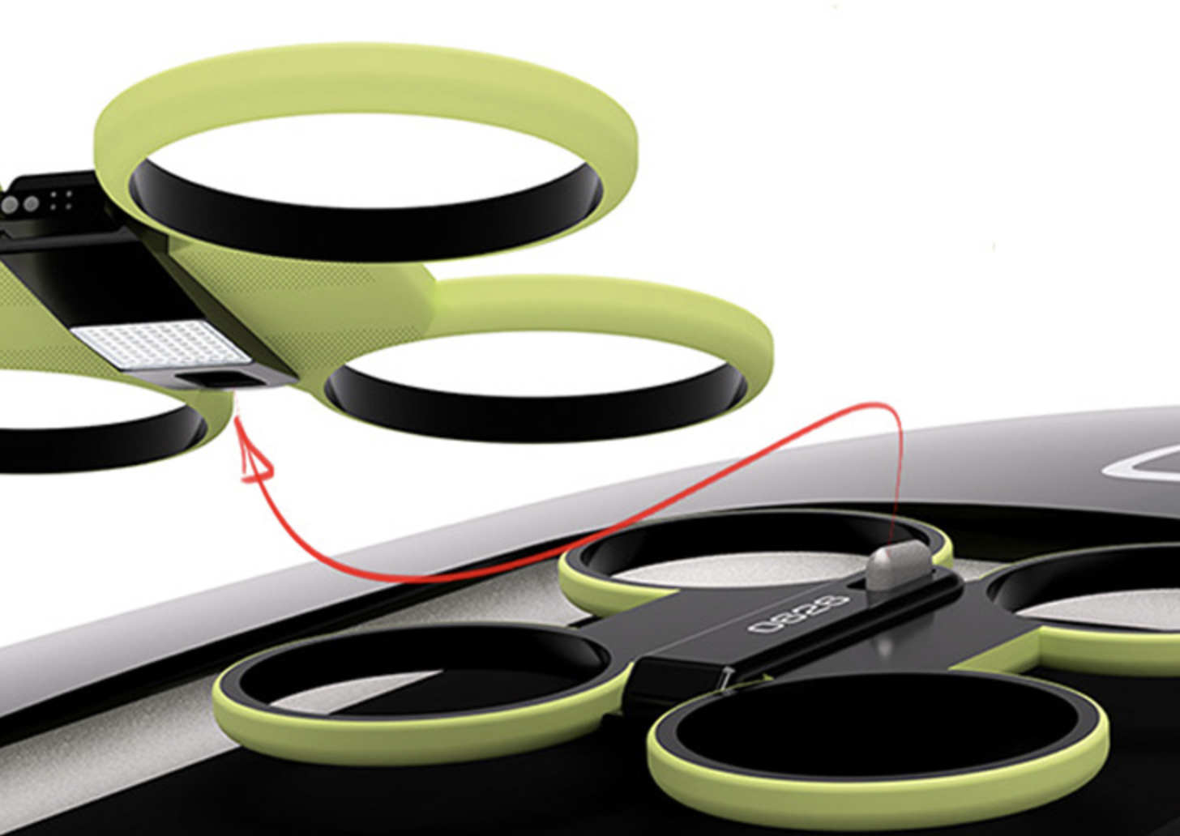
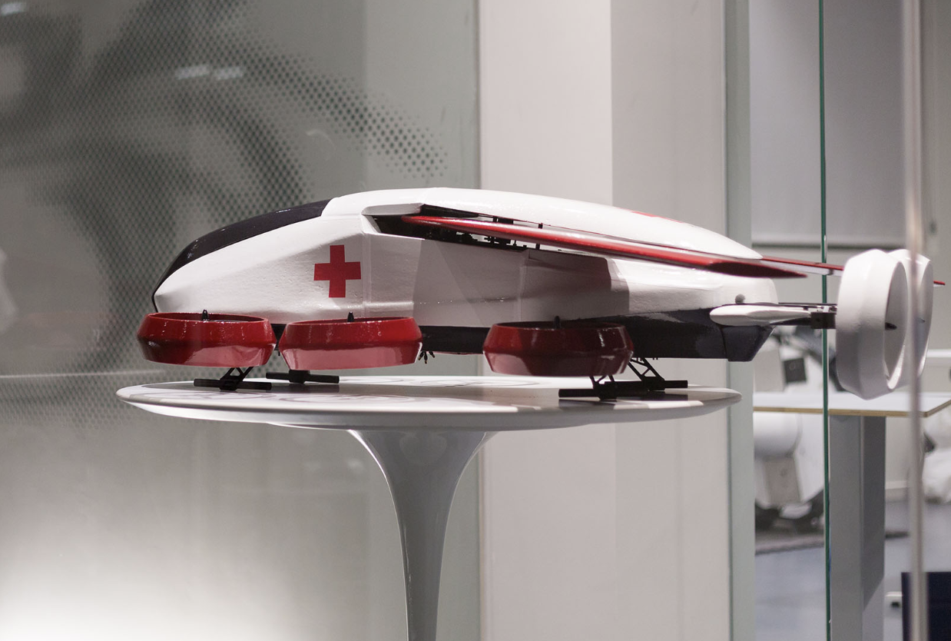
Some Interesting Ideas
Notes:
Volksvegan design showcase
Expressway Ambulance System on Behance
Drones to clear way in crowded cities with autonomous ambulance
Drone based autonomous ambulance

Slide 21
Overview
Overview of our project =
Explained by syam

